Slide 1
IT for Management: On-Demand Strategies for Performance, Growth, and Sustainability
Eleventh Edition
Turban, Pollard, Wood
Chapter 12
IT Strategy, Sourcing, and Strategic Technology Trends

Slide 2
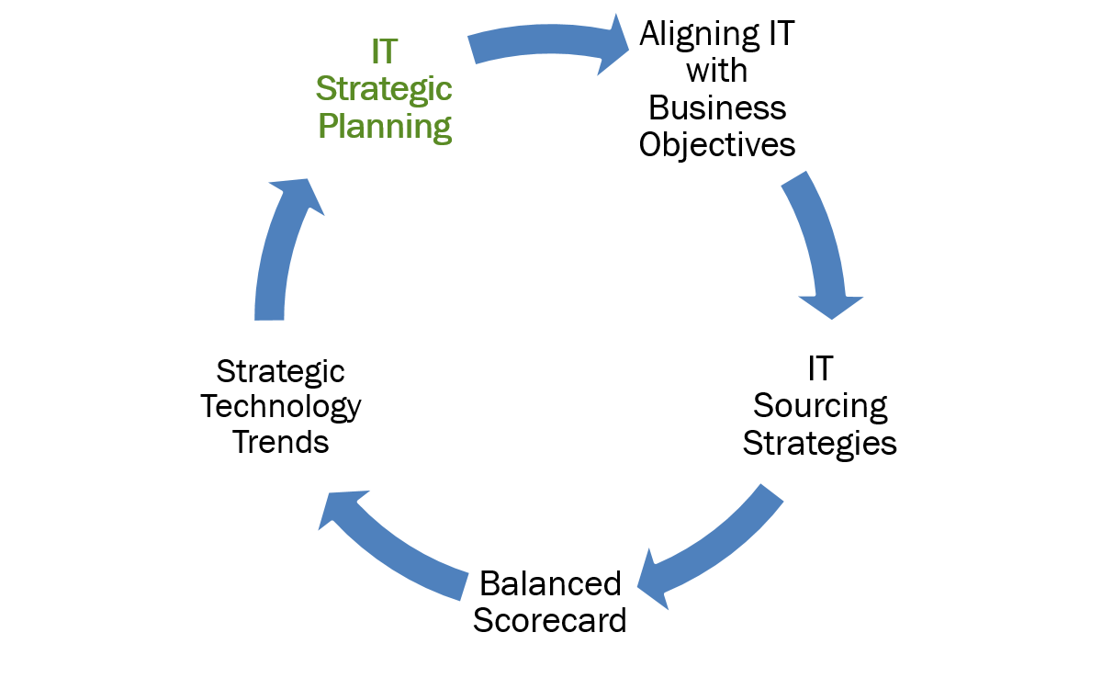
Learning Objectives (1 of 5)

Slide 3
IT Strategy
IT Strategy
  A plan of action to create an organization’s IT capabilities for maximum and sustainable value in the organization.
Business strategy
  sets the overall direction of a company
  defines how a business will achieve its mission, goals, and objectives
  specifies the necessary financial requirements, budgets, and resources

Slide 4
IT Strategic Planning
Strategic Planning
  A series of processes in which an organization selects and arranges its businesses or services to keep the organization healthy or able to function even when unexpected events disrupt one or more of its businesses, markets, products, or services.
Strategy
  The plan for how a business will achieve its mission, goals, and objectives including questions such as:
    What is the long-term business direction?
    What is the overall plan for deploying resources?
    What trade-offs are necessary?
    How do we achieve competitive advantage over rivals in order to achieve or maximize profitability?

Slide 5
IT Strategic Planning: Value Drivers
Enhance the value of a product or service to consumers, creating value for the company (such as advanced IT, reliability, and brand reputation).
  Three general types of Business Value Drivers:
  Operational Shorter-term factors
  Financial Medium-term factors
  Sustainability Long-term factors

Slide 6
IT Strategic Plan Objectives
IT Strategies Support the Business Strategy
Four IT Strategic Plan Objectives:
  Improve management’s understanding of IT opportunities and limitations
  Assess current performance
  Identify capacity and human resource requirements
  Clarify the level of investment required

Slide 7
Strategic Planning Issues
IT and Business Disconnects
  Not all business leaders will work with IT to achieve success.
Corporate and IT Governance
  A company can outsource the work, but not the responsibility for it.
Reactive Approaches Fail
  Failure to align to real business needs
  Fail to deliver value to the business

Slide 8
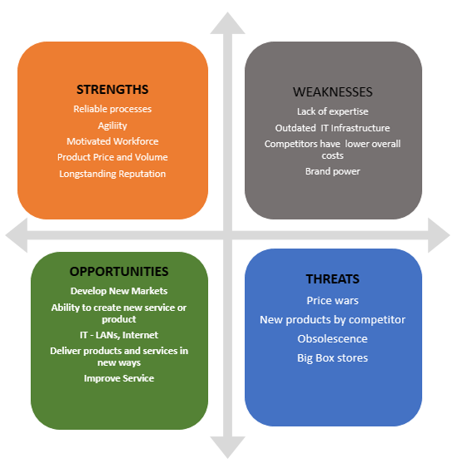
Strategic Planning Tools: SWOT
Figure 12.2: SWOT Analysis consists of a realistic evaluation of internal strengths & weaknesses and external opportunities and threats.

Slide 9
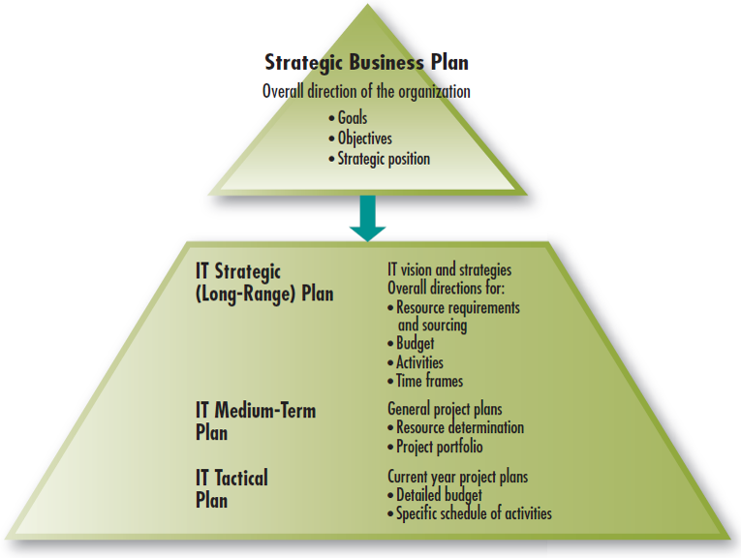
Figure 12.3: IT strategic planning process

Slide 10
Levels of the Strategic Plan
Long-range IT Plan (3-5 years)
  What IT should do to achieve the goals, objectives, and strategic position of the firm and how this will be achieved
  The overall direction, requirements, and sourcing of resources
Medium-term IT plan
  Identifies general project plans in terms of the specific requirements and sourcing of resources as well as the project portfolio
Tactical Plan (Short-range)
  Details budgets and schedules for current-year projects and activities

Slide 11
Strategic Plan Portfolios
Project Portfolio
  Lists major resource projects that are consistent with the long-range plan.
Applications Portfolio
  A list of major, approved information system projects that are also consistent with the long-range plan.

Slide 12
IT Steering Committee Tasks (1 of 2)
IT Steering Committee should:
Set the direction
  Links corporate strategy with the IT strategy,
Allocate scarce resources
  Approves the allocation of resources for and within the information systems organization including outsourcing policy.
Make staffing decisions
  Key IT personnel decisions involve a consultation and approval process made by the committee, including outsourcing decisions.

Slide 13
IT Steering Committee Tasks (2 of 2)
IT Steering Committee should:
Communicate and provide feedback
  Information regarding IT activities should flow freely.
Set and evaluate performance metrics
  Establish performance measures for the IT department and see they are met.

Slide 14
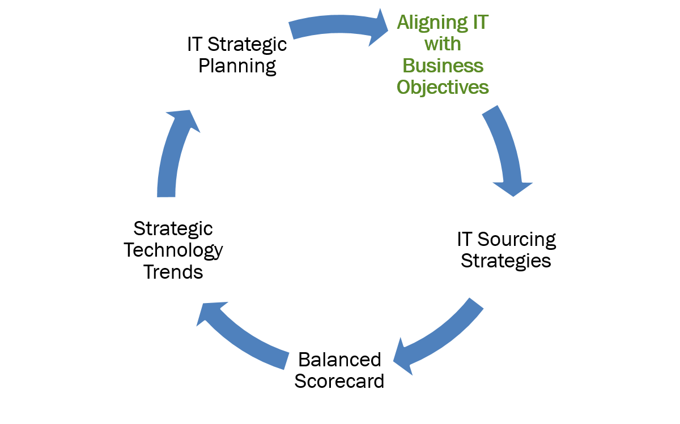
Learning Objectives (2 of 5)

Slide 15
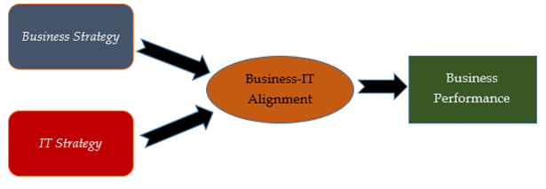
Aligning IT with Business Objectives
Figure 12.4 The Role of aligning IT strategy with business strategy to achieve organizational strategic objectives is still one of the most important key issues that challenges IT executives.

Slide 16
Business-IT Alignment
Business-IT alignment
  Refers to applying IT in an appropriate and timely way that is consistent with business strategies, goals and needs.
Business-IT alignment improved by focus on:
  Commitment to IT planning by senior management
  CIO is a member of senior management
  Understanding IT and corporate planning
  Shared culture and good communication
  Multilevel links

Slide 17
The CIO’s Role
CIO Skillset
  Political savvy
  Influence, leadership, and power
  Relationship management
  Resourcefulness
  Strategic planning
  Doing what it takes
  Leading employees

Slide 18
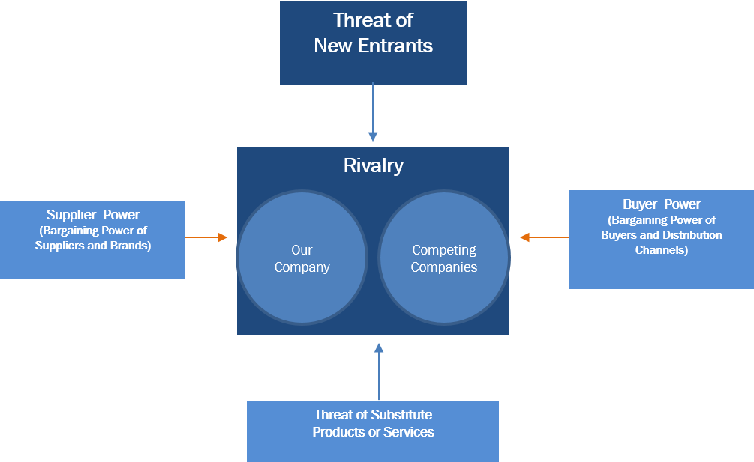
Porter’s Competitive Forces Model: The Five Forces

Slide 19
Achieving a Competitive Advantage: Strategies for Competitive Analysis
Cost leadership | Produce product/service at the lowest cost in the industry
Differentiation | Offer different products, services, or product features
Niche | Select a narrow scope segment (Market niche) and be the best in quality, speed, or cost in that segment

Slide 20
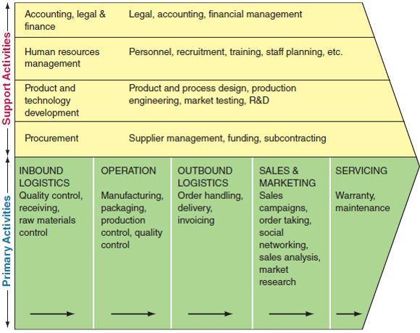
Porter’s Value Chain Model
Figure 12.6 Porter’s Value Chain. The arrows represent the flow of goods, services, and data in an organization.

Slide 21
Value Chain Support Activities
Support Activities
  Applied to any or all of the primary activities which may also support each other.
  Infrastructure, accounting, finance, and management
  Human resource (HR) management
  Technology development, and research and development (R&D)
  Procurement or purchasing

Slide 22
Aligning IT with Business Objectives
What are the three categories of value drivers?
Why do reactive approaches to IT investments fail?
What is the goal of IT–business alignment?
Why is IT strategic planning revisited on a regular basis?
What are the functions of a steering committee?
Describe the IT strategic planning process.
Explain how a good IT strategy can help companies gain a competitive advantage in the marketplace.
What are the five competitive forces in Porter’s Five Forces Model?
Notes:
Suggested Answers:
1. Operational (shorter-term factors that impact cash flow and the cash generation ability through increased efficiency or growth),
Financial (medium-term factors that minimize the cost of capital incurred by the company to finance operations), and
Sustainability (long-term survival factors; factors that enable a business to continue functioning consistently and optimally for a long time.)
2. Two of the biggest risks and concerns of top management are (1) failing to align IT to real business needs and, as a result, (2) failing to deliver value to the business. Reactive IT investments tend to be patches that rarely align with the business strategy.
3. Answers may vary. IT–business alignment means how closely an organization’s IT strategy is interwoven with and driving its overall business strategy. The goal of IT strategic alignment is to ensure that IS priorities, decisions, and projects are consistent with the needs of the entire business. Failure to properly align IT with the organizational strategy can result in large investments in systems that have a low payoff, or not investing in systems that potentially have a high payoff.
4. The business and IT strategic plans are evaluated and adjusted annually to keep pace with rapid changes in the industry. Because organizational goals change over time, it is not sufficient to develop a long-term IT strategy and not re-examine the strategy on a regular basis. For this reason, IT planning is an ongoing process. The IT planning process results in a formal IT strategy or a reassessment each year or each quarter of the existing portfolio of IT resources.
5. The steering committee is a team of managers and staff representing various business units that establish IT priorities and ensure the IT department is meeting the needs of the enterprise. The steering committee’s major tasks are:
Set the direction. In linking the corporate strategy with the IT strategy, planning is the key activity.
Allocate scarce resources. The committee approves the allocation of resources for and within the information systems organization. This includes outsourcing policy.
Make staffing decisions. Key IT personnel decisions involve a consultation-and-approval process made by the committee, including outsourcing decisions.
Communicate and provide feedback. Information regarding IT activities should flow freely.
Set and evaluate performance metrics. The committee should establish performance measures for the IT department and see that they are met. This includes the initiation of SLAs.
The success of steering committees largely depends on the establishment of IT governance, formally established statements that direct the policies regarding IT alignment with organizational goals and allocation of resources.
6. The entire planning process begins with the creation of a strategic business plan. The long-range IT plan, sometimes referred to as the strategic IT plan, is then based on the strategic business plan. The IT strategic plan starts with the IT vision and strategy, which defines the future concept of what IT should do to achieve the goals, objectives, and strategic position of the firm and how this will be achieved. The overall direction, requirements, and sourcing—either outsourcing or insourcing—of resources, such as infrastructure, application services, data services, security services, IT governance, and management architecture; budget; activities; and timeframes are set for three to five years into the future. The planning process continues by addressing lower-level activities with a shorter time frame.
The next level down is a medium-term IT plan, which identifies general project plans in terms of the specific requirements and sourcing of resources as well as the project portfolio. The project portfolio lists major resource projects, including infrastructure, application services, data services, and security services that are consistent with the long-range plan. Some companies may define their portfolio in terms of applications. The applications portfolio is a list of major, approved information system projects that are also consistent with the long-range plan. Expectations for sourcing of resources in the project or applications portfolio should be driven by the business strategy. Since some of these projects will take more than a year to complete, and others will not start in the current year, this plan extends over several years.
The third level is a tactical plan, which details budgets and schedules for current-year projects and activities. In reality, because of the rapid pace of change in technology and the environment, short-term plans may include major items not anticipated in the other plans.
The planning process just described is currently practiced by many organizations. Specifics of the IT planning process, of course, vary among organizations. For example, not all organizations have a high-level IT steering committee. Project priorities may be determined by the IT director, by his or her superior, by company politics, or even on a first-come, first-served basis.
The deliverables from the IT planning process should include the following: an evaluation of the strategic goals and directions of the organization and how IT is aligned; a new or revised IT vision and assessment of the state of the IT division; a statement of the strategies, objectives, and policies for the IT division; and the overall direction, requirements, and sourcing of resources.
7. A good IT strategy can help achieve business-IT alignment by allowing a firm to make the most of its IT investments, and increase profitability by attaining accord between its business strategies and plans. Even though firms instinctively expect benefits from IT alignment, many of them are resistant to achieving alignment. However, it can result in a competitive advantage if executed properly.
8. Porter’s five competitive forces are:
Threat of entry of new competitors
Bargaining power of suppliers
Bargaining power of customers or buyers.
Threat of substitute products or services
Competitive rivalry among existing firms in the industry

Slide 23
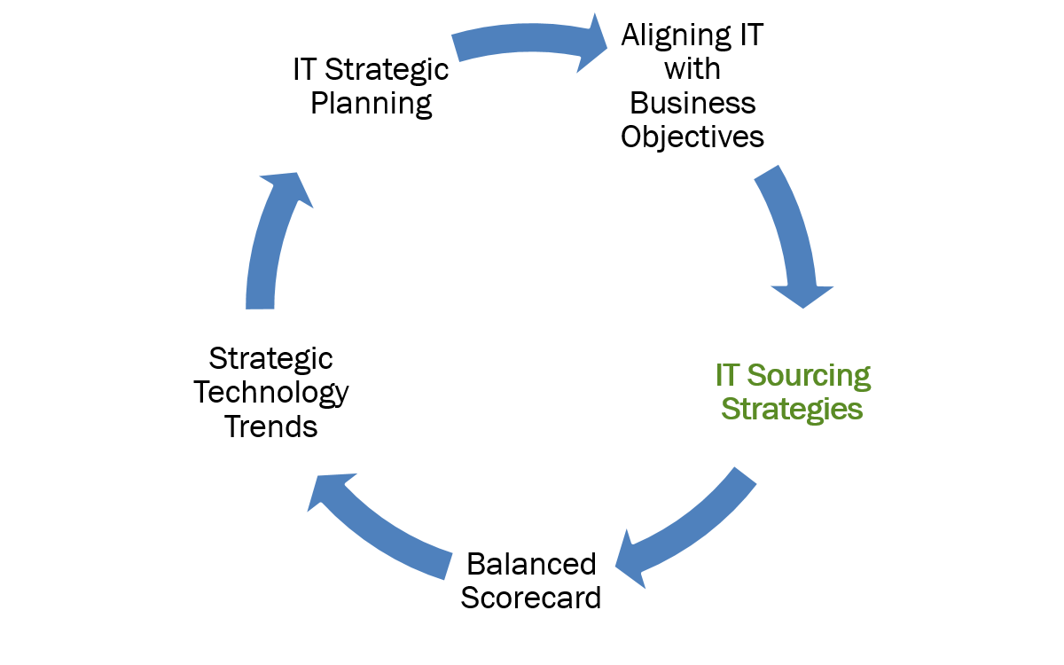
Learning Objectives (3 of 5)

Slide 24
IT Sourcing Strategies
IT Deployment Strategies
In-house development
  Systems are developed or other IT work is done in-house, possibly with the help of consulting companies or vendors.
Sourcing
  Onshore: sourced to consulting companies or vendors that are within the same country.
  Offshoring: work sourced to other countries.

Slide 25
Cloud Strategy Challenges
Cloud Complexity
Extensibility
  The ability to get data into and out of the cloud service
Migration Issues
  Cybersecurity, privacy, data availability, and service accessibility
Newer Challenges
  Cloud integration with on-premises resources, extensibility, and reliability

Slide 26
Outsourcing Challenges: Lessons Learned
Manage change by securing the commitment of senior leaders
Assess organizational readiness
Anticipate risks and formulate a plan for mitigating them
Build project management infrastructure
Create a governance mechanism
Properly define how success will be measured

Slide 27
Factors Driving Outsourcing
Reasons Why Organizations Outsource IT
  Generate revenue
  Increase efficiency
  Agile enough to respond to market changes
  Enterprise can focus on core competency
  Cut operational costs
  More accepted IT strategy
  Cloud and SaaS have been proven
  Differentiation from competitors
  Reduce burden on internal IT department

Slide 28
Outsourcing Risks, Hidden Costs (1 of 2)
Outsourcing Risks
Shirking
  The vendor deliberately underperforms while claiming full payment.
Poaching
  The vendor develops a strategic application for a client and then uses it for other clients.
Opportunistic repricing
  Client enters into a long-term contract with a vendor, the vendor changes financial terms at some point or overcharges for unanticipated enhancements and contract extensions.

Slide 29
Outsourcing Risks, Hidden Costs (2 of 2)
Breach of contract by vendor.
  Vendor fails to carry out the terms of .the agreement.
Inability of vendor to deliver as promised.
  Outsourcers unable to deliver the products or services.
Vendor lock-in.
  In the event that the outsourcing relationship does not go well, it can be difficult to get out of the outsourcing agreement.
Loss of Control over data.
  Organization has little control over how and when their data can be accessed and by whom
Lower employee morale.
  IT employees may feel devalued.

Slide 30
Offshoring
Work Not Readily Offshored
  Work that has not been routinized.
  Work that if offshored would result in the client company losing too much control over critical operations.
  Situations in which offshoring would place the client company at too great a risk to its data security, data privacy, or intellectual property and proprietary information.
  Business activities that rely on an uncommon combination of specific application domain knowledge and IT knowledge in order to do the work properly.

Slide 31
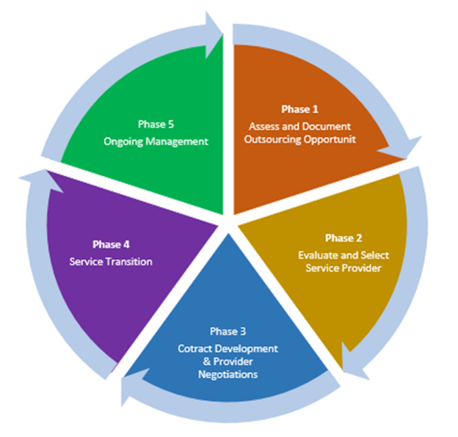
Five Phase Outsourcing Life Cycle

Slide 32
Managing IT Vendor Relationships
Finding and Selecting a Vendor
  Experience with very similar systems of similar size, scope, and requirements; experience with the ITs that are needed, integrating those ITs into the existing infrastructure and the customer’s industry.
  Financial and qualified personnel stability. A vendor’s reputation impacts its stability.
Ask for “Proof of Concept” or a Trial Run
  Vendor demonstration of product to see how well it works
Get Everything in Writing

Slide 33
IT Sourcing and Cloud Strategy
What contributes to the complexity of a cloud strategy?
How does tactical adoption of cloud services differ from a coordinated cloud strategy?
What is onshore sourcing?
What are the major reasons for sourcing?
What types of work are not readily outsourced offshore?
When selecting a vendor, what two criteria need to be assessed?
What is the risk of putting too great an emphasis on cost when selecting or dealing with an IT vendor?
What needs to be done before signing a contract with an IT vendor?
Why would a company want to invest in strategic technologies?
Notes:
Suggested Answers:
1. While the concept of cloud is simple, an enterprise’s cloud strategy tends to be quite complex. Cloud is being adopted across more of the enterprise, but mostly in addition to on-premises systems—not as full replacements for them. Hybrid solutions create integration challenges. Cloud services—also referred to as edge services—have to integrate back to core internal systems.
2. Tactical adoption is a short-sighted approach, deploying cloud services incrementally, resulting in apps and services that are patched together to create end-to-end business processes.
3. Work or development can be sourced to con-sulting companies or vendors that are within the same country, which is referred to as onshore sourcing.
4. Enterprises choose outsourcing for several reasons:
To generate revenue
To increase efficiency
To be agile enough to respond to changes in the marketplace
To focus on core competency
To cut operational costs
Because offshoring has become a more accepted IT strategy
Because cloud computing and SaaS have proven to be effective IT strategies
To move IT investment from a capital expenditure to a recurring operational expenditure
To differentiate from competitors—while reducing the burden on the IT organization
5. Based on case studies, the types of work that are not readily offshored include the following:
Work that has not been routinized
Work that if offshored would result in the client company losing too much control over critical operations
Situations in which offshoring would place the client company at too great a risk to its data security, data privacy, or intellectual property and proprietary information
Business activities that rely on an uncommon combination of specific application-domain knowledge and IT knowledge in order to do the work properly.
6. When selecting a vendor, two criteria to assess first are experience and stability:
Experience with very similar systems of similar size, scope, and requirements. Experience with the ITs that are needed, integrating those ITs into the existing infrastructure and the customer’s industry.
Financial and qualified personnel stability. A vendor’s reputation impacts its stability.
7. Many corporate customers lose out on the potential benefit of close relationships by an overemphasis on costs instead of value. Ideally, a customer/vendor relationship is a mutually beneficial partnership, and both sides are best served by treating it as such.
8. Vendors often buy hardware or software from other vendors. In order to avoid problems with the primary IT vendor, check secondary suppliers as well. Ask the primary vendor how they will deliver on their promises if the secondary vendors go out of business or otherwise end their relationship.
Vendors may offer the option to test their products or services in a pilot study or a small portion of the business to verify that it fits the company’s needs. If the vendor relationship adds value on a small scale, then the system can be rolled out on a larger scale. If the vendor cannot meet the requirements, then the company avoids a failure.
Before entering into any service contract with an IT vendor, get a promise of service in writing. By making both parties aware of their responsibilities and when they may be held liable for failing to live up to those responsibilities, a strong SLA can help prevent many of the disruptions and dangers that can come with sourcing or migrating to the cloud. The provisions and parameters of the contract are the only protections a company has when terms are not met or the arrangement is terminated. No contract should be signed without a thorough legal review.
SLAs are designed to protect the service provider, not the customer, unless the customer takes an informed and active role in the provisions and parameters. There is no template SLA and each cloud solution vendor is unique. Certainly, if a vendor’s SLA is light on details, this alone may be an indicator that the vendor is light on accountability. Additionally, if a sourcing or cloud vendor refuses to improve its SLAs or negotiate vital points, then that vendor should not be considered.
9. To gain the competitive advantage they need to flourish, companies need to strategically invest in emerging strategic technology to widen their set of core competencies and help them differentiate themselves in the market, expand their existing market or move into different markets. (Section 12.5)

Slide 34
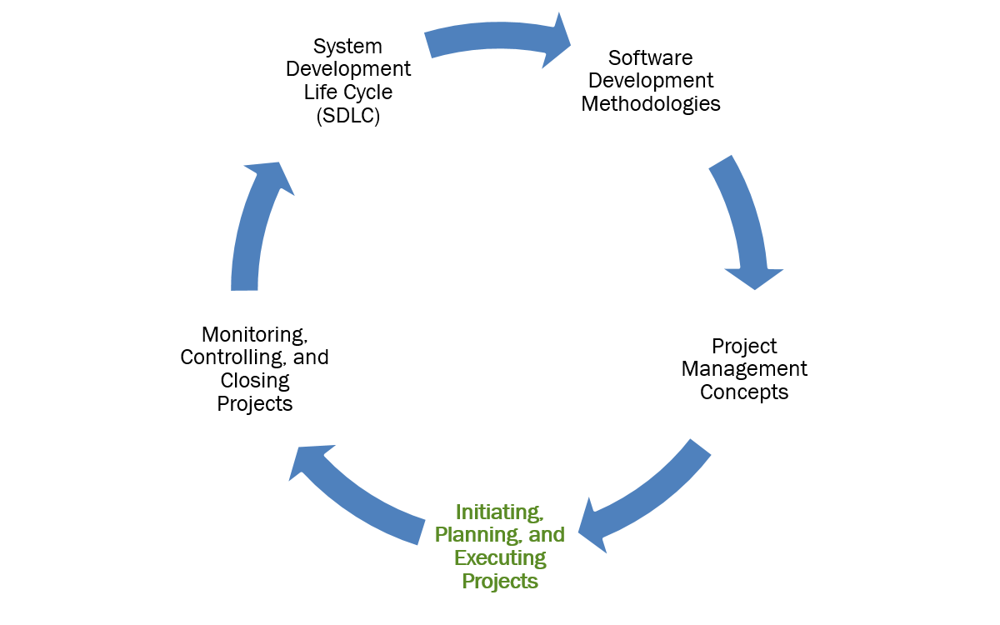
Learning Objectives (4 of 5)

Slide 35
Balanced Scorecard (BSC)
Typical Approach to Business: quantify past performance
Lagging Indicators
  P&L, Cash Flow, Balance Sheets
  Confirm what has already happened
  Represent history, not ideal for managing day-to-day operations and planning
Balanced Scorecard Approach: multidimensional
Leading indicators
  Predict future events to identify opportunities.

Slide 36
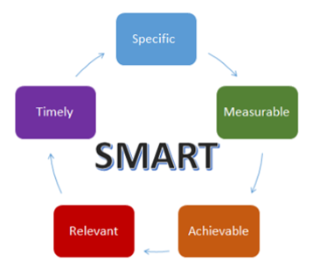
Figure 12.8 SMART Criteria objectives should meet

Slide 37
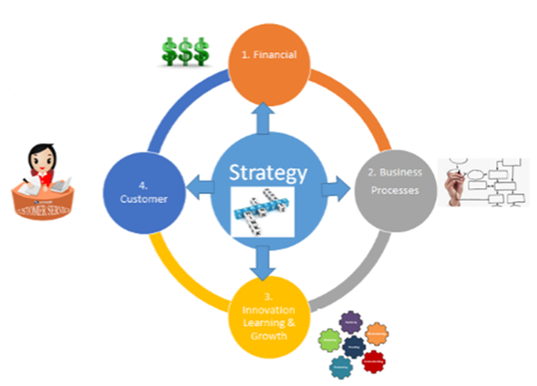
Figure 12.9 Balanced Scorecard (BSC) uses four metrics to measure performance—one financial metric and three nonfinancial metrics

Slide 38
Balanced Scorecard Metrics
Balanced Approach Perspectives
Financial
  Revenue, earnings, asset utilization
Customer
  Market share, Brand image, price-value relationship
Business processes
  Cycle times, cost per process/transaction
Innovation, learning and growth
  Employee skills, IT capabilities, R&D

Slide 39
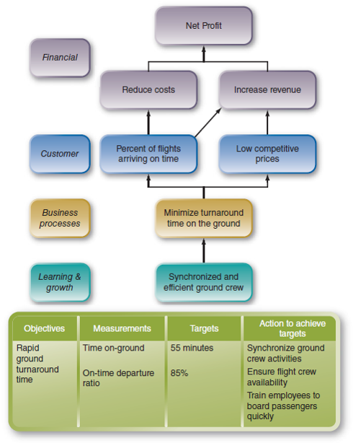
Figure 12.10 : Overview of a low-cost airline’s BSC objectives, measures, targets, and actions to achieve targets

Slide 40
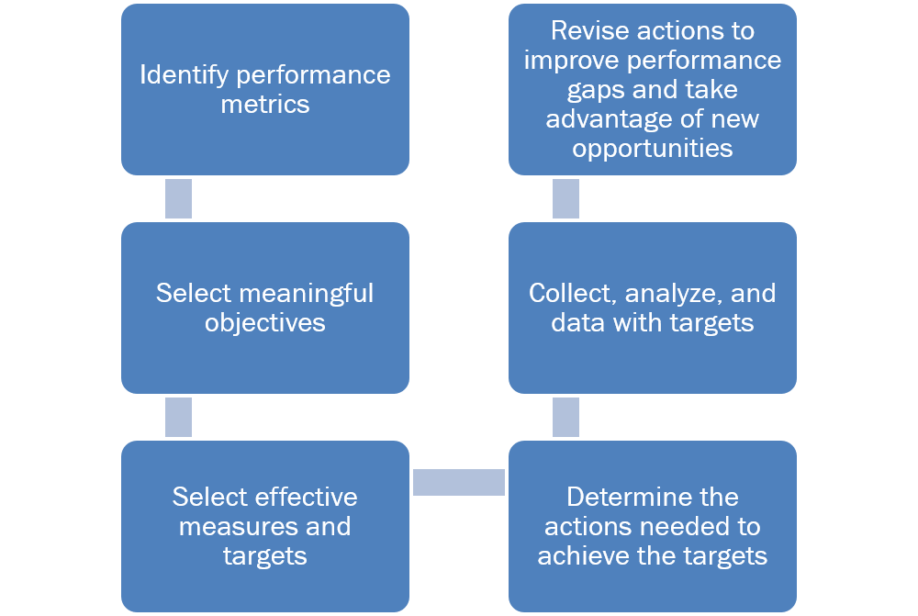
The BSC Methodology

Slide 41
Balanced Scorecard
How did the BSC approach differ from previous measurement approaches?
How does the BSC approach “balance” performance measurements?
What are the four BSC perspectives?
Give an example of each BSC metric.
How does BSC align IT strategy with business strategy?
Notes:
Suggested Answers:
1. Prior to the BSC concept, the typical business objective could be summed up simply as to make a profit. Performance metrics were based on:
P&L (profit and loss) reports: revenue, expenses, net profit
Cash flow statements: enough cash to pay its current liabilities
Balance sheets that reflected the overall status of finances at a certain date
These financial metrics are lagging indicators because they quantify past performance. As such, they represent historical information and are not ideal tools for managing day-to-day operations and planning.
What was novel about BSC in the 1990s was that it measured a company’s performance using a multidimensional approach of leading indicators as well as lagging indicators.
2. The BSC method is “balanced” because it does not rely solely on traditional financial measures. Instead, it balances financial measures with three forward-looking nonfinancial measures.
3. Financial. To succeed financially, how should we appear to our investors and shareholders?
Customer. To achieve our vision, how should we provide value to our customers?
Business processes. To satisfy our shareholders and customers, what business processes must we focus on and excel at?
Innovation, learning, and growth. To achieve our vision, how will we sustain our ability to innovate, learn, change, and improve?
4. Answers may vary.
Perspective Examples of Measurement Criteria
Financial • Revenue and revenue growth rates
• Earnings and cash flow
• Asset utilization
Customer • Market share
• Customer acquisition, retention, loyalty
• Customer relationships, satisfaction, likes, recommendations, loyalty
• Brand image, reputation
• Price–value relationship
Business • Cycle times, defect rate
processes • Production throughput, productivity rates
• Cost per process
• Cost per transaction
Innovation, • Employee skills, morale, turnover, capacity for change
learning and • IT capabilities
growth • Employee motivation
• R&D
• Percentage of revenue from new products/services
5. BSC can be used to translate strategic plans and mission statements into a set of objectives and performance metrics that can be quantified and measured.
BSC is used to clarify and update the strategy, align the IT strategy with the business strategy, and link strategic objectives to long-term goals and annual budgets.
The astute student may realize that the balanced scorecard can be applied to link KPIs of IT to business goals to determine the impact on the business. The focus for the assessment could be, for example, the project portfolio or the applications portfolio. The balanced scorecard can be used to assess the IT project portfolio by listing projects along the vertical dimension, and specific measures, critical to what the organization needs to track, horizontally.

Slide 42
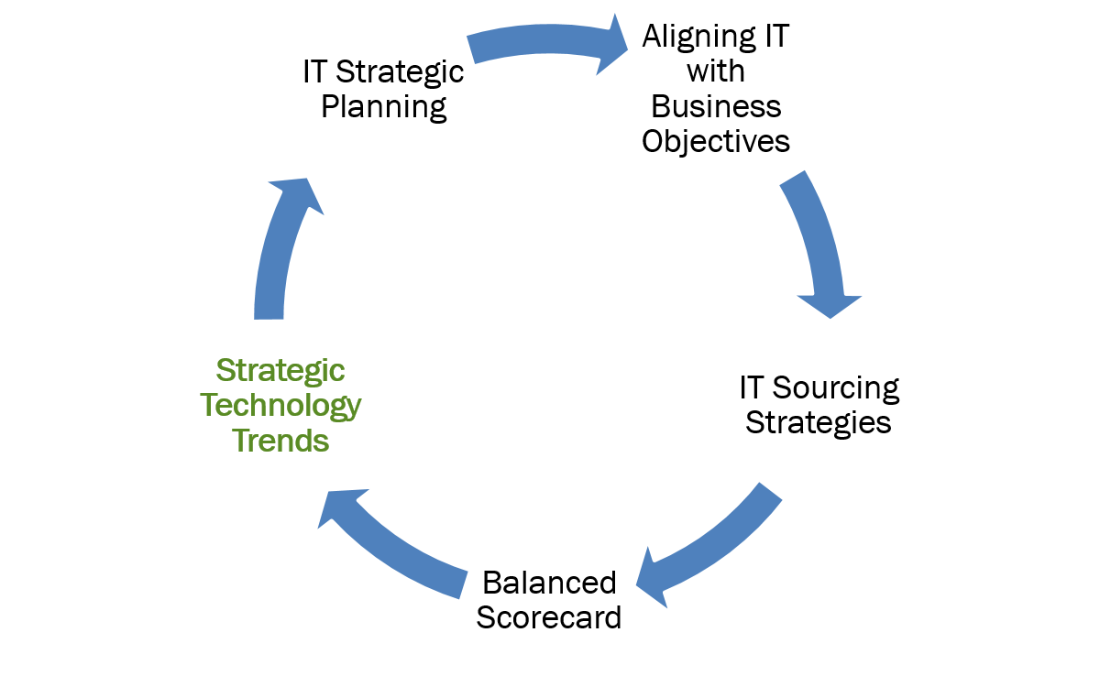
Learning Objectives (5 of 5)

Slide 43
Strategic Technology Trends (1 of 2)
Gartner’s Top 10 Strategic Technology Trends (2017):
Artificial Intelligence and Machine Learning
  Robots, autonomous vehicles, consumer electronics
Intelligent Apps
  Virtual Personal Assistant (VPA), Virtual Customer Assistance (VCA)
Intelligent Things
  Drones, smart appliances
Virtual and Augmented Reality
  Immersive content in mobile, wearables, IOT
Digital Twin
  Dynamic software model of a physical thing

Slide 44
Strategic Technology Trends (2 of 2)
Gartner’s Top 10 Strategic Technology Trends (2017):
Blockchain and Distributed Ledgers
  Peer-to-peer networked token or bitcoin chains
Conversational System
  Greater cooperative interaction between devices
Mesh App and Service Architecture (MASA)
  Mesh of back end services linking apps
Digital Technology Platforms
  Building blocks for a digital business
Adaptive Security Architecture
  New remediation tools to protect IoT

Slide 45
Strategic Technology Scanning
Every organization needs to continually scan for emerging technologies to enhance IT strategy
Improvements gained can range from incremental to revolutionary
Scanning approaches include:
  General Technology Search
  Technology Mapping
  Systems Modeling
  Customer Requirements Analysis
  Analysis of Specific Technologies

Slide 46
Finding Strategic Technologies
Major research centers and technology conferences
  COMDEX, IBM InterConnect
  Google Next, Adobe Summit, HIMSS
Look for emerging technologies
  Digital mesh is an expanded sets of endpoints used to access applications, gather information or interact with people, to ensure instant connection and response to build experience.
    Smart devices, wearables, consumer and home electronic devices
Companies need to strategically invest in emerging technologies

Slide 47
Copyright
Copyright © 2018 John Wiley & Sons, Inc.
All rights reserved. Reproduction or translation of this work beyond that permitted in Section 117 of the 1976 United States Act without the express written permission of the copyright owner is unlawful. Request for further information should be addressed to the Permissions Department, John Wiley & Sons, Inc. The purchaser may make back-up copies for his/her own use only and not for distribution or resale. The Publisher assumes no responsibility for errors, omissions, or damages, caused by the use of these programs or from the use of the information contained herein.

