Slide 1
IT for Management: On-Demand Strategies for Performance, Growth, and Sustainability
Eleventh Edition
Turban, Pollard, Wood
Chapter 13
Systems Development and Project Management

Slide 2
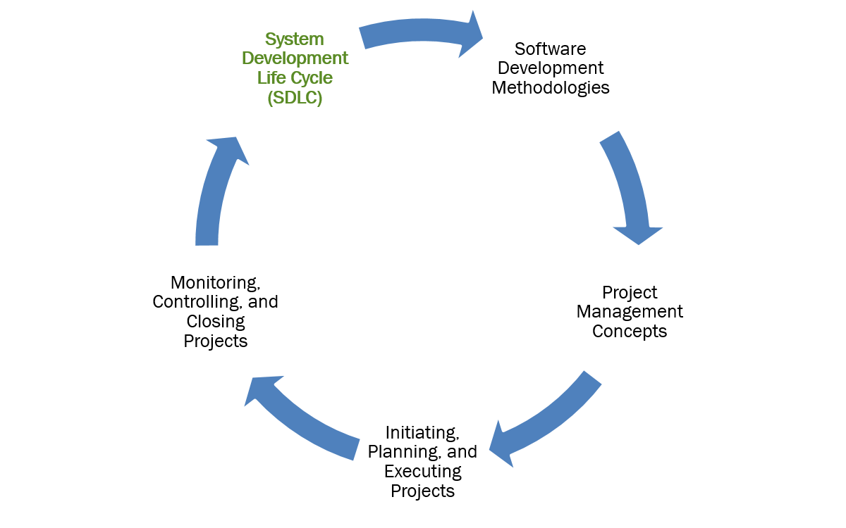
Learning Objectives (1 of 5)

Slide 3
System Development Life Cycle
System Development Life Cycle (SDLC) is a multiple stage approach used by IT professionals to develop high-quality information systems from planning and analysis through support and maintenance.
  The SDLC provides a framework for a number of different systems development methodologies.
  The activities performed during systems development vary depending on the size and complexity of the system.

Slide 4
Stages of the SDLC
Systems Planning
Systems Analysis
Systems Design
Implementation and Testing
Support and Maintenance
The SDLC is an iterative process, not a linear one.

Slide 5
Systems Planning
  During Systems Planning:
    Planning begins when a business need is identified.
    Problem or desired change is described.
    Planning stage objective is to determine feasibility of the request.
    The deliverable from the planning stage is the Project Plan.
A feasibility study in this stage determines the probability of success of a proposed system and provides a rough assessment of its technical, economic, organizational, and behavioral feasibility.

Slide 6
Systems Analysis
  During Systems Analysis:
    User requirements are gathered to better understand the problem
    Process models are created to determine the logical design of the system
    End product of this stage is a Systems Proposal.
More time invested in analysis mean a greater probability of IS success.

Slide 7
Systems Design
System developers utilize the design specifications to create the user interface and establish data requirements
Physical design of the system is designed by determining and acquiring the hardware and software needed to carry out the logical design of the system
User and system documentation are created
Management and user involvement are critical to ensure that business requirements are being met
The deliverable from the design stage is the System Design Specification

Slide 8
Implementation and Testing
Implementation
  Conversion of the old system to the new system
    Plunge: cut off and migration at a specific time
    Parallel: simultaneous transfer
    Pilot: limited test of new, then roll out
    Phased: specific components in stages
Testing
  Testing verifies that apps, interfaces, data transfers, and so on, work correctly under all possible conditions.
  Users are trained in the use of the new system.

Slide 9
Support and Maintenance
Occurs once new system’s operations are stabilized.
  Audits are performed to assess capabilities and determine operational correctness.
  Maintenance must be kept up to date at all times.
  Users kept up to date on latest modifications and procedures.
  Systems development is a repetitive process as maintenance turns into the development of a new system.

Slide 10
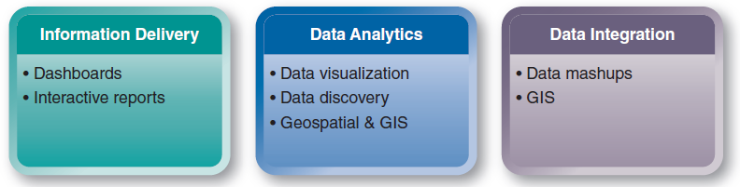
Data Visualization Technologies
Figure 11.3 Tools and technologies in this chapter fall into three related categories.

Slide 11
System Development Life Cycle
What are the five stages of the SDLC?
Name the deliverables from three of the five SDLC stages.
Explain the purpose of feasibility tests and why they are important in developing information systems.
Is the systems development process a linear or a cyclical process? Explain.
Name the four system conversion methods.
Notes:
Suggested Answers:
1. The systems development life cycle (SDLC) stages are planning; analysis; design; implementation/testing, and support/maintenance. Each process consists of well-defined tasks that depend on the scope of the project. The processes are iterative, which means that they are revised when new information or conditions make a revision the smart thing to do. Iteration does not mean that system development should be subject to infinite revisions or scope creep.
2. The deliverable from the planning stage is a Project Plan. The deliverable from the systems analysis stage is the Systems Proposal. The deliverable from the design stage is the System Design Specification.
3. The feasibility study determines the probability of success of the proposed project and provides a rough assessment of the project‘s technical, economic, organizational, and behavioral feasibility. The feasibility study is critically important to the systems development process because, done properly, the study can prevent organizations from making expensive mistakes, such as creating systems that will not work, that will not work efficiently, or that people cannot or will not use. The Census Bureau case in IT at Work 13.1 is an example. The various feasibility analyses also give the stakeholders an opportunity to decide what metrics to use to measure how a proposed system meets their objectives.
After the feasibility analysis, a “Go/No-Go” decision is reached. The project sponsor and project manager sign off on the decision. If it is a no-go decision, the project is put on the shelf until conditions are more favorable, or the project is discarded. If the decision is “go,” then the system development project proceeds.
4. The SDLC is an iterative process, not a linear one. This means that when results from one stage are assessed they can be revised, if needed, and a previous stage can be revisited before continuing onto the next stage.
5. Four conversion strategies are parallel, direct cut over, pilot, and phased.
In a parallel conversion, the old system and the new system operate simultaneously for a period of time. That is, both systems process the same data at the same time, and the outputs are compared. This type of conversion is the most expensive but least risky.
In a direct conversion, the old system is cut off and the new system is turned on at a certain point in time. This type of conversion is the least expensive, but it is the most risky if the new system does not work as planned.
A pilot conversion introduces the new system in one location to test it out. After the new system works properly, it is rolled out.
A phased conversion introduces components of the new system, such as individual modules, in stages. Each module is assessed, and, when it works properly, other modules are introduced until the entire new system is operational.

Slide 12
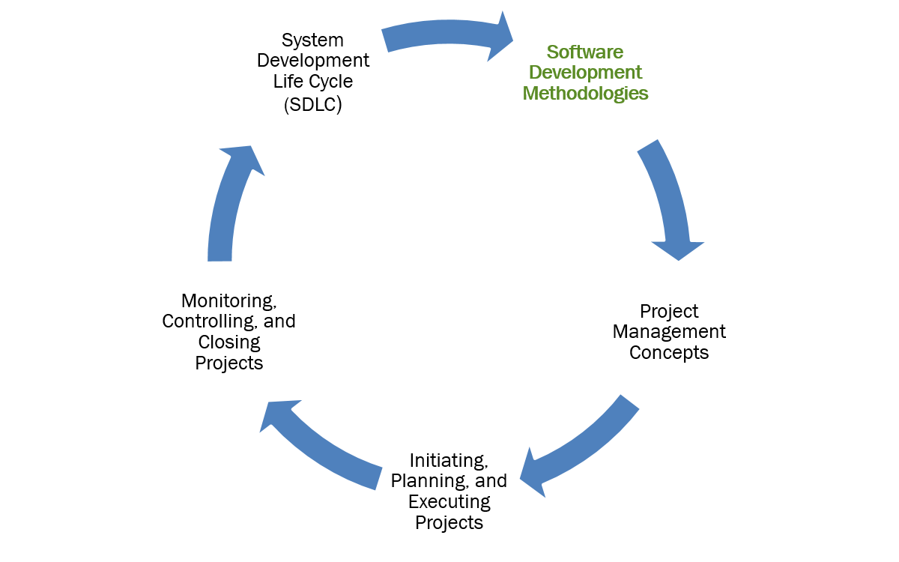
Learning Objectives (2 of 5)

Slide 13
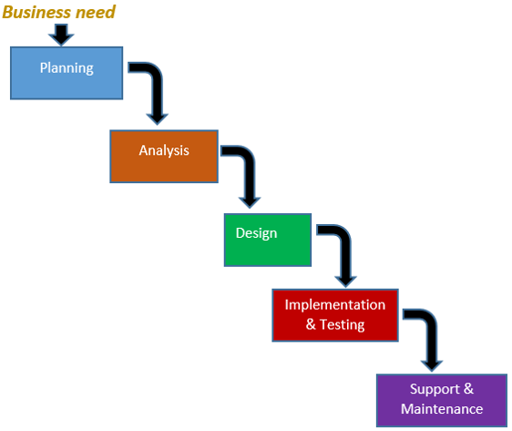
Software Development Methodologies: Waterfall
Waterfall Method
Sequential
Predictive
Inflexible
No going back
Recordkeeping essential
Small, short-term projects

Slide 14
Software Development Methodologies: Object-Oriented
Object-Oriented (O-O) Analysis and Design
  Iterative, Adaptive
  Emphasizes modularity and reusability
  Views a system as a collection of modular objects that encapsulate data and processes.
  Objects = people, things, transactions and events
  Use cases and Unified Modelling Language (UML), a set of symbols to graphically represent the various components and relationships within a system

Slide 15
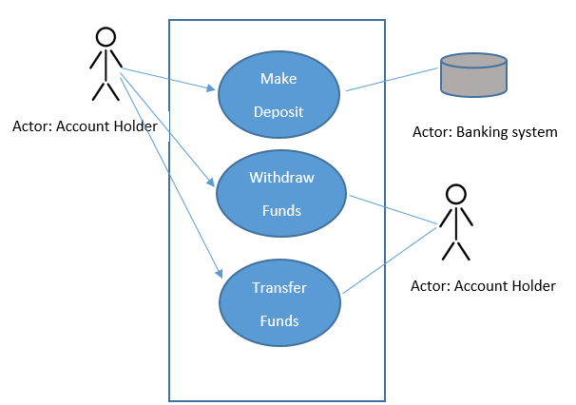
Figure 13.3: An Object-Oriented Use Case Model has two parts, the use case diagram and the use case description. Here’s a simple example of an account holder interacting with a Banking ATM.

Slide 16
Software Development Methodologies: Agile
Agile Methodology
  Most flexible of all development methodologies
  Software components delivered early and often
  Iterative, incremental approach
  Variations: Scrum, Extreme Programming

Slide 17
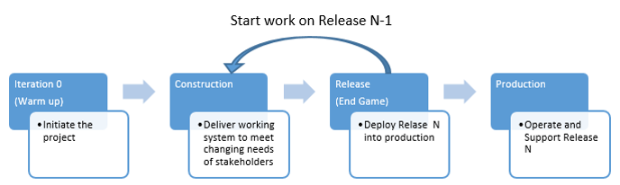
Figure 13.4 Stages in the Agile Methodology

Slide 18
Software Development Methodologies: DevOps
DevOps: DEVelopment and IT OPerations
  Emphasizes collaboration between software developers, operators and testers involved in the development and operations of information systems
  Developed to address gap in communication and collaboration
  Creates culture where building, testing and delivery of a system can happen quickly, frequently and reliably
  Lowers failure rate of new releases
  Shortens time to market

Slide 19
Software Development Methodologies
Name the different types of systems development methodologies.
What the is the main difference between the waterfall method and the agile method?
Why is it important for an organization to be flexible when developing information systems?
Why is the concept of DevOps appealing to organizations?
Notes:
Suggested Answers:
The major systems development methodologies are waterfall, object-oriented and agile.
2. Agile uses an iterative, incremental approach to overcome the disadvantages of the sequential Waterfall Model.
3. Organizations need to be flexible in developing information systems to be able to respond to problems of rapid change occurring in the on demand economy, such as changes in market forces, system requirements and project staff.
4. Organizations that use DevOps have reported significant benefits such as shorter time to market, im-proved customer satisfaction, better product quality, more reliable release, improved productivity and efficiency, and the ability to build the right product.

Slide 20
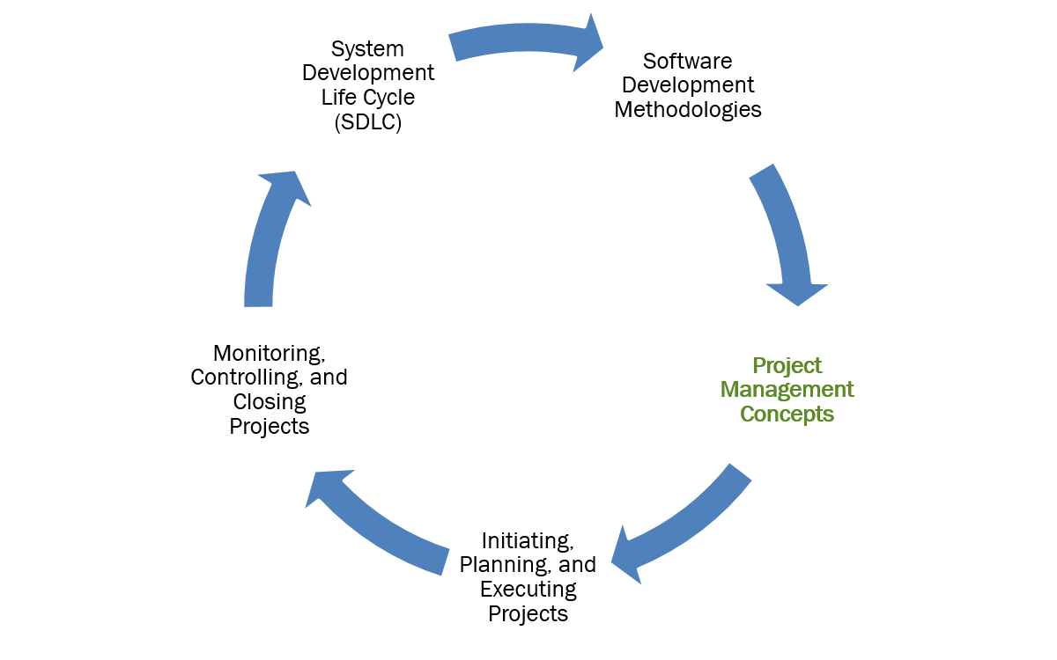
Learning Objectives (3 of 5)

Slide 21
Project Management Fundamentals
Project
  is a temporary endeavor undertaken to create a unique product, service or result
Project Management
  is the application of knowledge, skills, tools and techniques to project activities to meet project requirements
Deliverable
  is any measurable, tangible, verifiable outcome, result or item that is produced to complete a project or part of a project

Slide 22
What is a Project?
Operations vs. Projects
Operations
  Business as usual
Projects
  Clearly defined scope, deliverables, and results.
  Estimated time frame or schedule subject to a high degree of uncertainty.
  Estimated budget subject to a high degree of uncertainty.
  Requirement of extensive interaction among participants.
  Tasks that may compete or conflict with other business activities.
  Risky but with a high profit potential or benefits.
Portfolio is a set of projects.

Slide 23
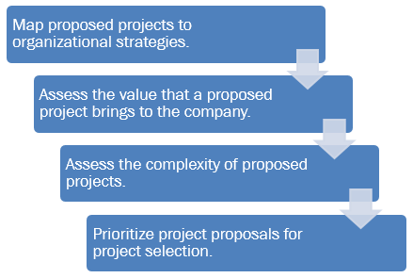
Choosing Projects: Project Portfolio Management Path

Slide 24
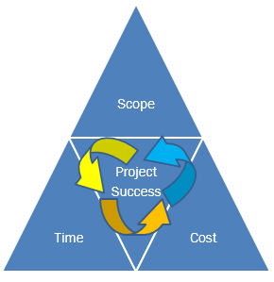
The Triple Constraint

Slide 25
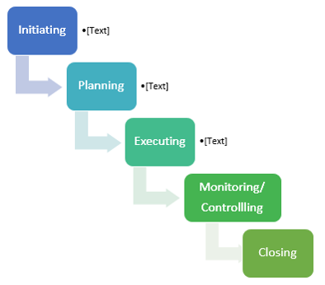
Figure 13.7: : The five phases of the project management life cycle. All projects, IT or otherwise, move through five phases of the project management life cycle.

Slide 26
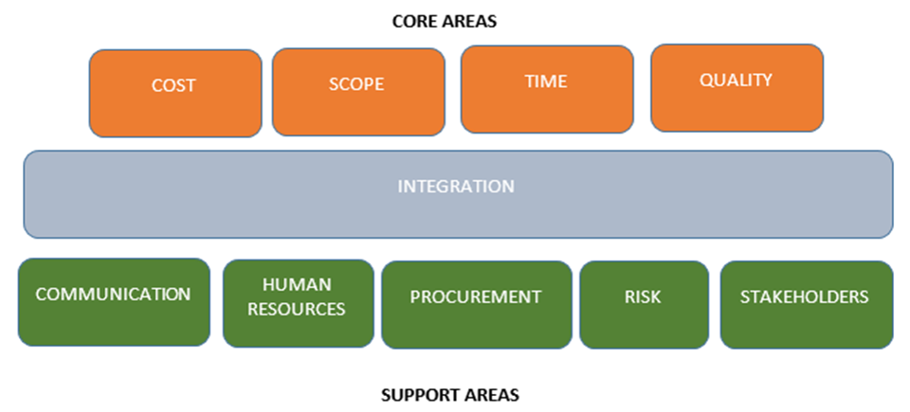
Ten Knowledge Areas of Project Management

Slide 27
Project Management Fundamentals
What distinguishes a project from day-to-day operations?
What are the three components of the triple constraint?
What are the five process groups in the project management life cycle?
Why is it important to use a structured project management approach to IT projects?
Notes:
Suggested Answers:
1. Projects differ from operations or business as usual based on these characteristics of a project:
Clearly defined scope, deliverables, and results
An estimated time frame or schedule that is subject to a high degree of uncertainty
An estimated budget that is subject to a high degree of uncertainty
The requirement of extensive interaction among participants
Tasks that may compete or conflict with other business activities, which makes planning and scheduling difficult
Risky but with a high profit potential or benefits
2. The triple constraint refers to the three attributes that must be managed effectively for successful completion and closure of any project:
Scope. The project scope is the definition of what the project is supposed to accomplish—its outcomes or deliverables. Scope is measured in terms of the project size, goals, and requirements.
Time. A project is made up of tasks. Each task has a start date and an end date. The duration of a project extends from the start date of the first task to the finish date of the last task. Time needed to produce the deliverables is naturally related to the scope and availability of resources allocated to the project.
Cost. This is the estimation of the amount of money that will be required to complete the project. Cost itself encompasses various things, such as resources, labor rates for contractors, risk estimates, and bills of materials, et cetera. All aspects of the project that have a monetary component are made part of the overall cost structure. Projects are approved subject to their costs.
3. The five phases or process groups of project management are: Initiating, Planning, Executing, Monitoring/Controlling and Closing.
4. Not using a structured project management approach is the biggest IT project mistake a business can make. Project management helps keep projects on schedule and on budget. A good project management plan identifies anticipated costs early on to develop a realistic budget. Using resource conflict solutions, project managers can minimize the effect of funding a new project on operating capital by optimizing the allocation of workers. Coordinating tasks and clearly identifying goals or deliverables within phases reduce inefficiencies in time management that can result in being over budget.

Slide 28
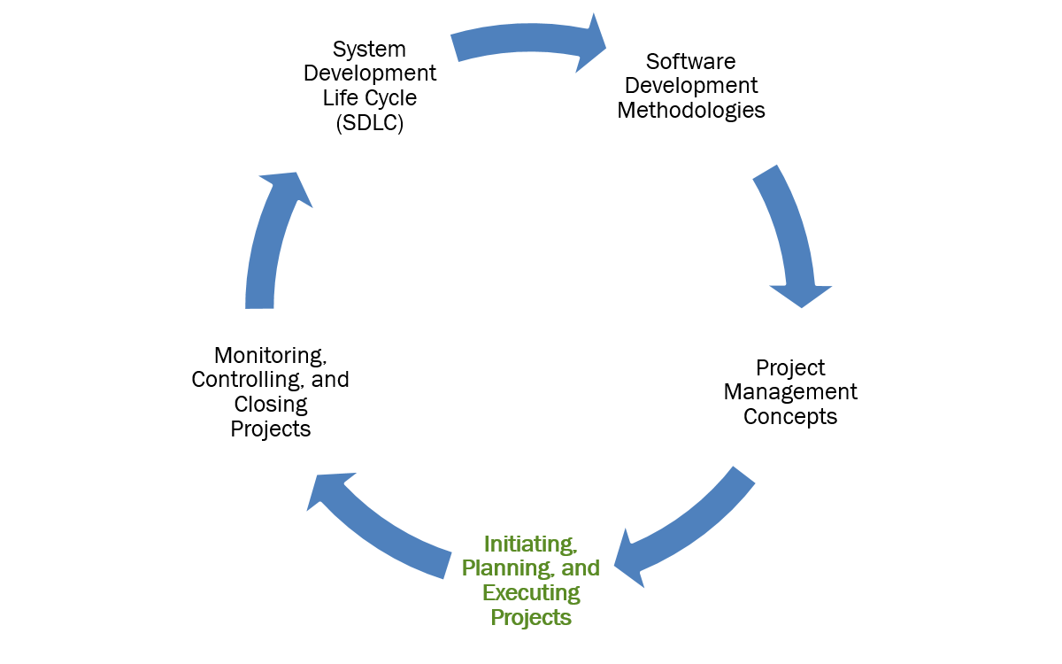
Learning Objectives (4 of 5)

Slide 29
Project Initiation
Business Case
  Presentation or document that outlines the justification for the start-up and funding of a project
Statement of Work (SOW)
  Definitive statement that defines the project plan, but does not offer any options or alternatives in the scope
Project Charter
  Specifies scope, authority, milestones, budget, source of funding for project

Slide 30
Project Planning
Work Breakdown Structure (WBS)
  Identifies all work or activities that need to be performed, the schedule of work, and who will perform the work.
  Milestones are used to manage the project work effort, monitor results, and report meaningful status to project stakeholders.
Risk Register
  Lists all known risks and an estimation of risks that could occur.
  Also lists the source of each risk, how you will respond to each risk and the name of the person responsible for addressing the risk.

Slide 31
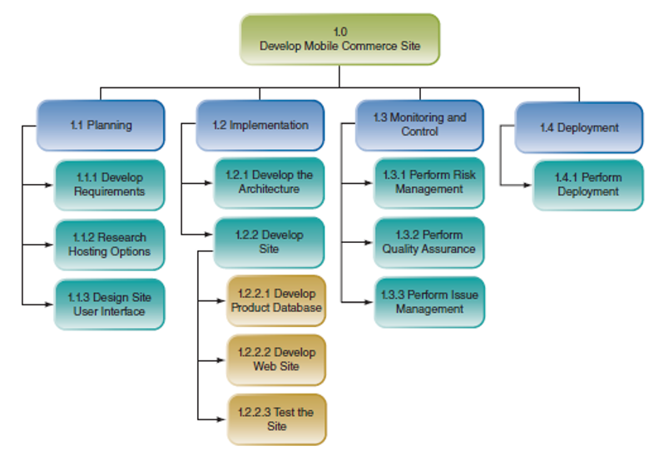
Figure 13.10 One segment of the WBS for a mobile commerce site project

Slide 32
Project Execution: Gantt Chart
A horizontal bar chart that shows the timeline of the project schedule showing start and finish dates of all milestones.

Slide 33
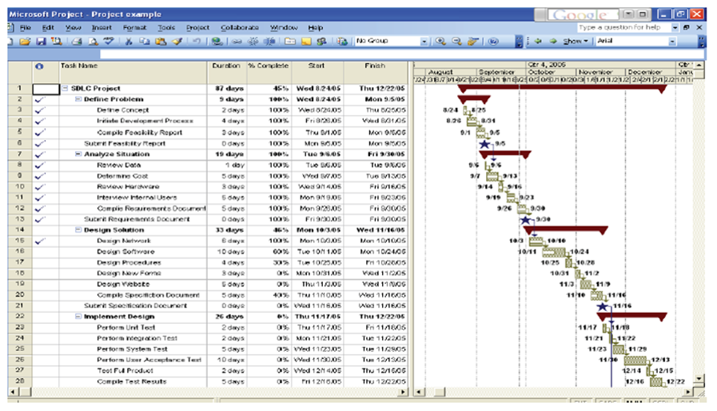
Figure 13.12 Microsoft Project screen shot of WBS (left side) and Gantt chart

Slide 34
Project Execution
Cost Estimation
  Costs are not technically part of the WBS, but projects’ estimated cost can be calculated from the WBS using start date and duration.
Responsibility Matrix
  Shows who has primary responsibility and who has support responsibility for the activities listed in the WBS.

Slide 35
Initiating, Planning, and Executing Projects
If the business case is accepted, what document is prepared?
What events are used to manage the project work effort, monitor results, and report a meaningful status to project stakeholders?
What shows who has primary responsibility and who has support responsibility for the tasks listed in the WBS?
What is the type of bar chart that shows the timeline of the project schedule?
Notes:
Suggested Answers:
1. If the business case is accepted, a statement of work (SOW) is prepared.
2. Milestones are used to manage the project work effort, monitor results, and report meaningful status to project stakeholders.
3. A responsibility matrix shows who has primary responsibility and who has support responsibility for the activities listed in the WBS.
4. A Gantt chart is a horizontal bar chart that graphically displays the project schedule.

Slide 36
Learning Objectives (5 of 5)

Slide 37
Project Monitoring: Status Report
Prepared and reviewed to check on the progress of the project
Typically prepared once a week
Can include a summary of the project status, work planned, work completed, open issues, open risks, status of project milestones and deliverables, open change requests, project KPIs, schedule status and cost status

Slide 38
Project Controlling: Changes
Is the piling up of small changes that by themselves are manageable but in aggregate are significant
Contributes to overages in budget, deadline, and/or resources
Standard project management approaches reduce scope creep

Slide 39
Project Monitoring: Status Report
Integrated Change Control
  Process helps to manage the disruption resulting from requested changes and corrective actions across the project life cycle.
  Required to defend:
    Approved/rejected change requests
    Updates to the project plan/scope
    Approved corrective and preventive actions
    Approved/validated defect repair

Slide 40
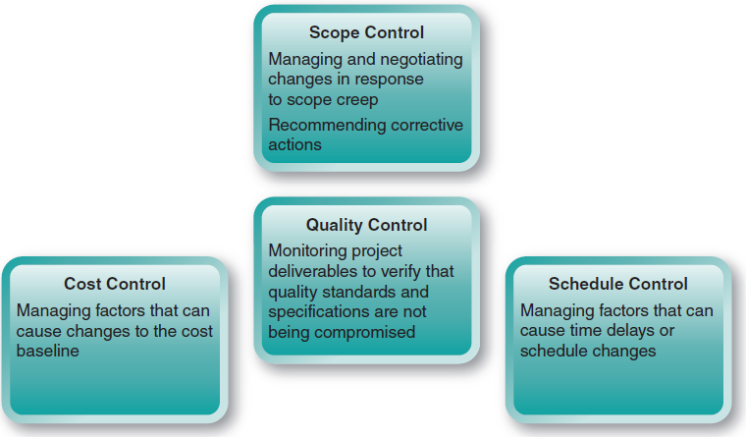
Figure 13.15 Project controls

Slide 41
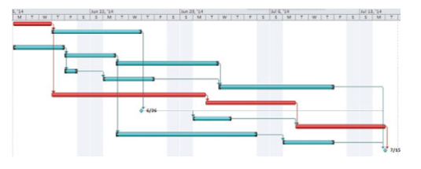
Project Control: Critical Path
Critical Path Analysis
Consists of all tasks from project start to finish that must be completed on time in order for the project to finish on time.
Figure 13.14: The critical path is shown as red bars.

Slide 42
Project Monitoring, Controlling, and Closing
Project Closing or Post Mortem
  Project closure does not benefit the completed project.
  The enterprise and people who worked on the project benefit from lessons learned.
  Post-project reviews, or post mortems, identify the reasons the project was successful or not, strengths and weaknesses of the project plan, how problems were detected and resolved, and how the project was successful in spite of them.

Slide 43
Project Closing: Lessons Learned
Communication is King
Set Realistic and Detailed Project Plans with Adequate Time and Resources
Encourage Timely Feedback and Be Willing to Listen
Manage Risk with Regular Project Status Reviews

Slide 44
Project Monitoring, Control, and Closing
What processes help to ensure that the impacts resulting from requested changes and corrective actions are managed across the project life cycle?
What is the longest path of tasks through a project?
Assuming no changes are made, what happens when a task on the critical path is delayed?
When the project plan is finalized and agreed to, what is any change to the baseline?
When are lessons learned from a completed project identified?
Notes:
Suggested Answers:
1. Integrated change control processes help to manage the disruption resulting from requested changes and corrective actions across the project life cycle.
2. A critical path is the longest path of tasks through a project.
3. The entire project is delayed.
4. . Any change to the baseline is a deviation, or variance, to the plan—and it needs to be documented.
5. Lessons learned are identified during the post-project review, or post mortem.

Slide 45
Copyright
Copyright © 2018 John Wiley & Sons, Inc.
All rights reserved. Reproduction or translation of this work beyond that permitted in Section 117 of the 1976 United States Act without the express written permission of the copyright owner is unlawful. Request for further information should be addressed to the Permissions Department, John Wiley & Sons, Inc. The purchaser may make back-up copies for his/her own use only and not for distribution or resale. The Publisher assumes no responsibility for errors, omissions, or damages, caused by the use of these programs or from the use of the information contained herein.

